Slide 1
Static electricity
MS864M

Slide 2
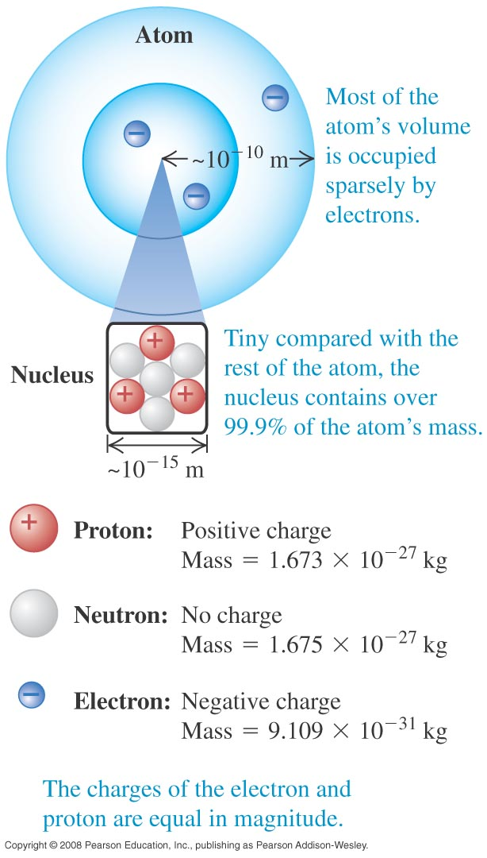
Atomic structure
Atoms are made up of :
negative electrons
positive protons
neutrons
There are two kinds of charges.
We differentiate them by “+” and “-” signs.
An electron has a charge of -1.6x10⁻¹⁹ C.
A proton has a charge of +1.6x10⁻¹⁹ C.

Slide 3
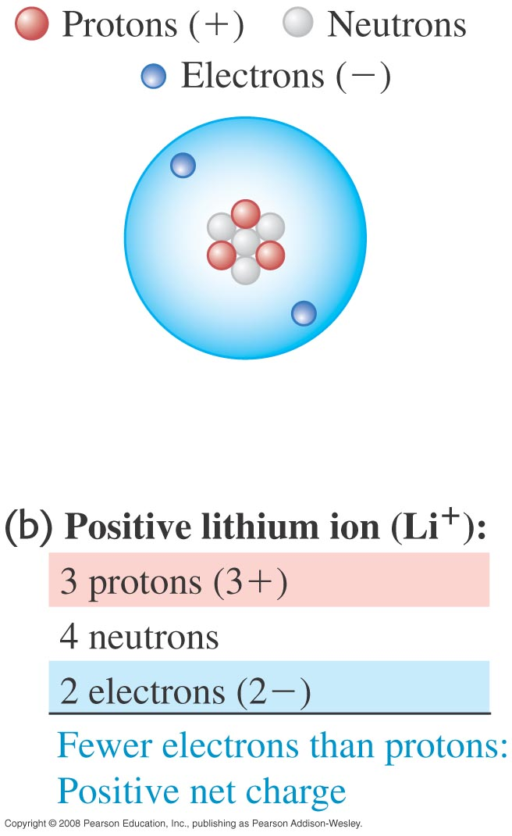
Ions
An ion is an atom with missing or extra electrons.
A positive lithium ion has 3 protons and 2 electrons.
A negative lithium ion has 3 protons and 4 electrons.
Static electricity is due to transfer of electrons between materials, resulting in either a net positive or net negative charge in the material.

Slide 4
Example 1
How many electrons will give you a total charge of -32×10⁻⁶ C?
Notes:
N = 2 × 10¹⁴

Slide 5
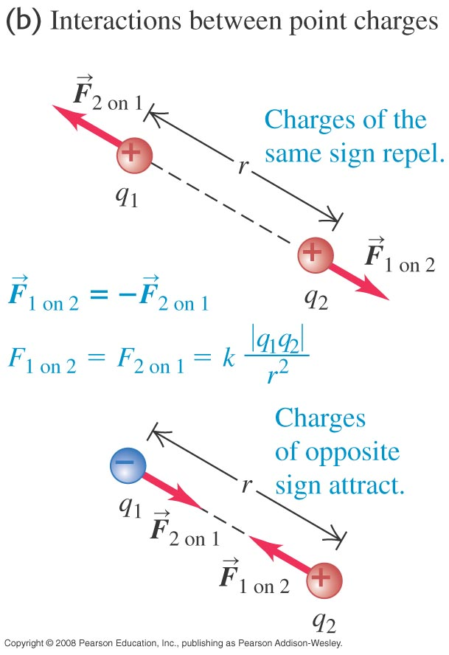
Coulomb’s Law
Force between two stationary point charges is given by Coulomb’s Law,
The magnitude of the force is
where k = 8.9876×10⁹ Nm²/ C² is the Coulomb constant.

Slide 6
Permittivity
The Coulomb’s constant can also be written as
where ε_{o} is called the permittivity of free space (vacuum) and has a value of 8.854×10⁻¹² C²/N m².
If the charges are in some medium, then
where ε is the permittivity of the medium.

Slide 7
Relative permittivity
The ratio is known as relative permittivity.
When sodium chloride is put into water of relative permittivity 80, the force between a sodium and chloride ion is reduced by 80 times.
This explains the high solubility of common salt (NaCl) in water.

Slide 8
Superposition of forces
The superposition principle states that the resultant force on any one charge equals the vector sum of the forces exerted by the other individual charges that are present, i.e.

Slide 9
Force on a charge due to other charges
Consider the three charges shown.
Imagine only q₁ and q₃ are present and draw the force F_{3 on 1}.
Next imagine only q₁ and q₂ are present and draw the force F_{2 on 1}.
The net force on q₁ is the vector sum of the two forces.
q₁
q₂
q₃
+
-
+
F_{3 on 1}
q₁
-
q₃
+
+
q₁
F_{2 on 1}
q₂
+
-
F_{3 on 1}
q₁
F_{2 on 1}
+

Slide 10
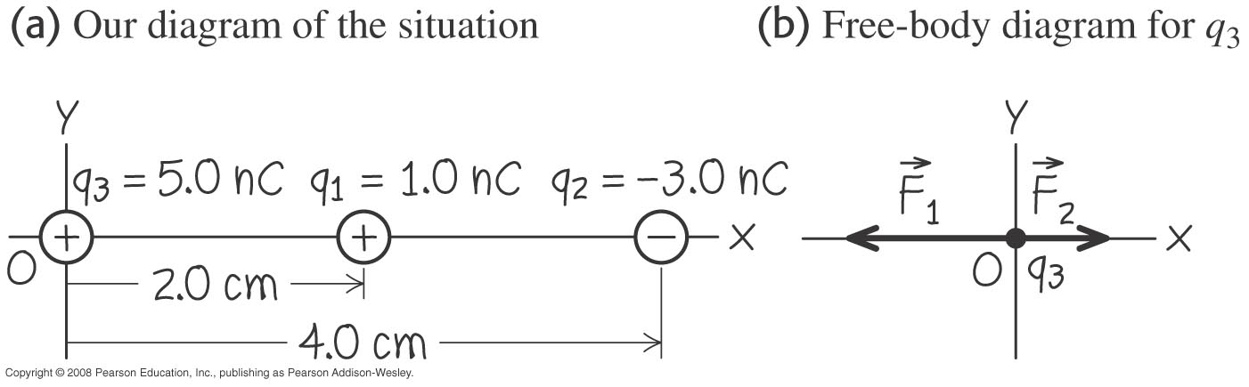
Example 2
Two point charges are located on the x-axis of a coordinate system: q₁ = 1.0 nC is at x = +2.0 cm and q₂ = −3.0 nC is at x = +4.0 cm. What is the total electric force exerted by q₁ and q₂ on a charge q₃ = 5.0 nC at x = 0?
Notes:
F = (−28 µN) i

Slide 11
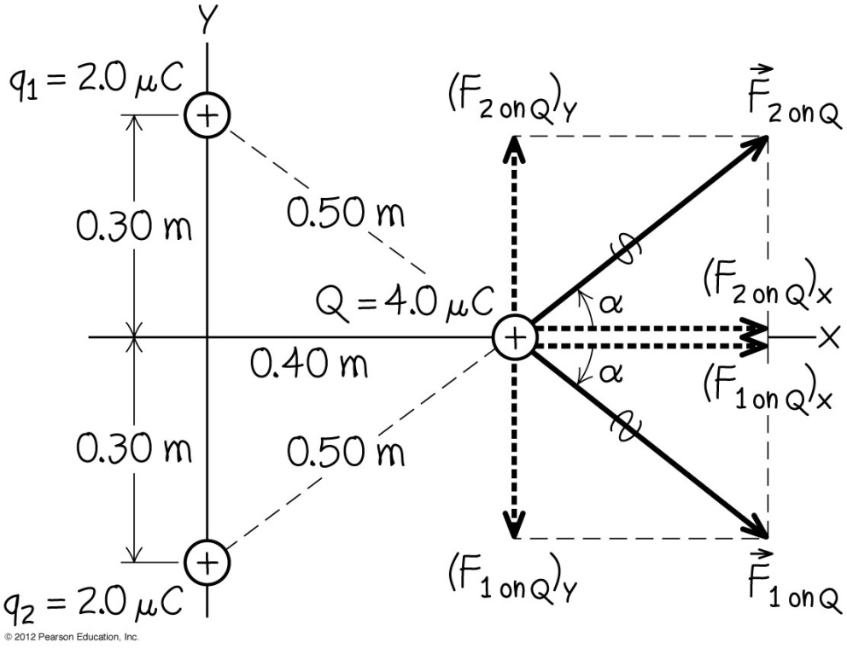
Example 3
Two equal positive charges point charges q₁ = q₂ = 2.0 µC are located at x = 0, y = 0.30 m and x = 0, y = −0.30 m respectively. What are the magnitude and direction of the total electric force that q₁ and q₂ exert on a third charge Q = 4.0 µC located at x = 0.4 m, y = 0?

Slide 12
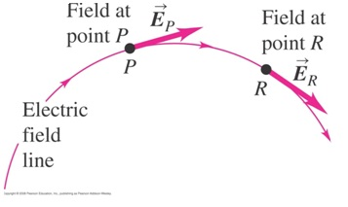
Electric field
An electric field is a region where an electric charge experiences an electric force.
Electric fields are represented by field lines.
The tangent at any point on a field line is the direction of the force that a positive charge would experience when placed at that point.

Slide 13
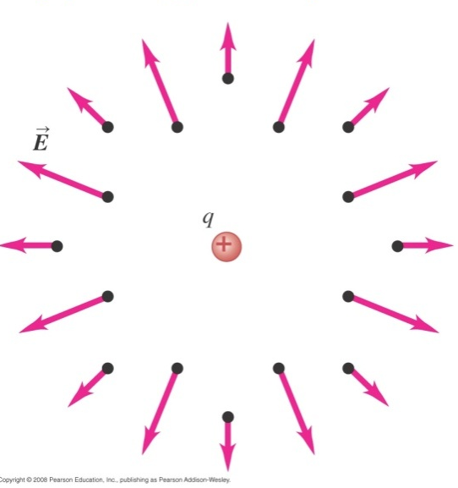
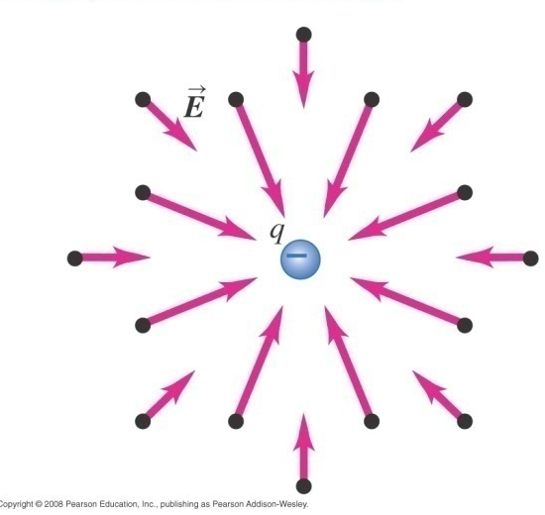
Electric field of point charges
For a single isolated positive point charge, the field lines always go away from the positive charge.
For a single isolated negative point charge, the field lines always go towards the negative charge.

Slide 14
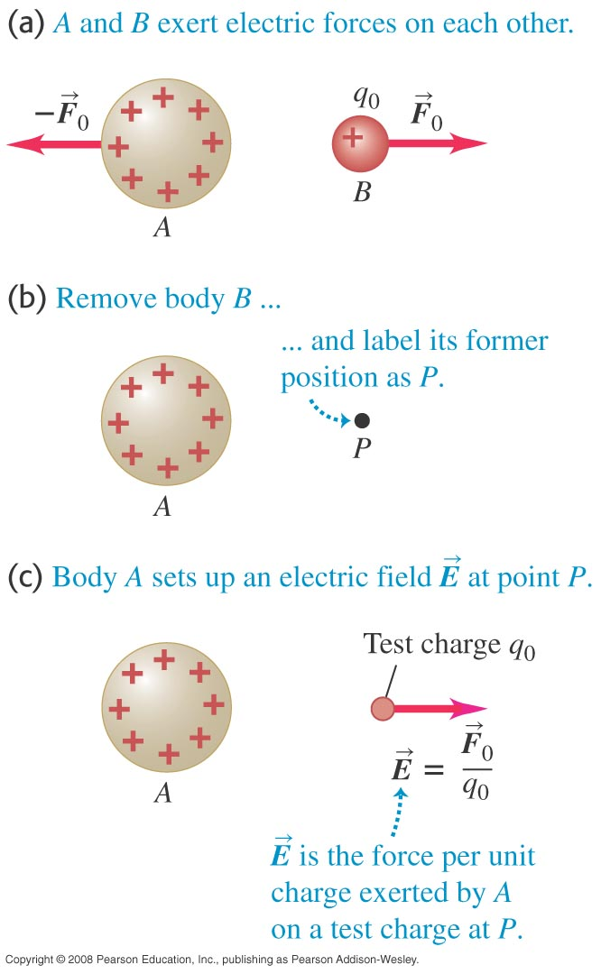
Electric field of a point charge
From Coulomb’s Law, force on q₀ is
The electric field at q₀ due to q_{A} is defined as
Its SI unit is N/C.
Note that we do not need to know q₀ when we are finding the field at q₀ due to q_{A}.

Slide 15
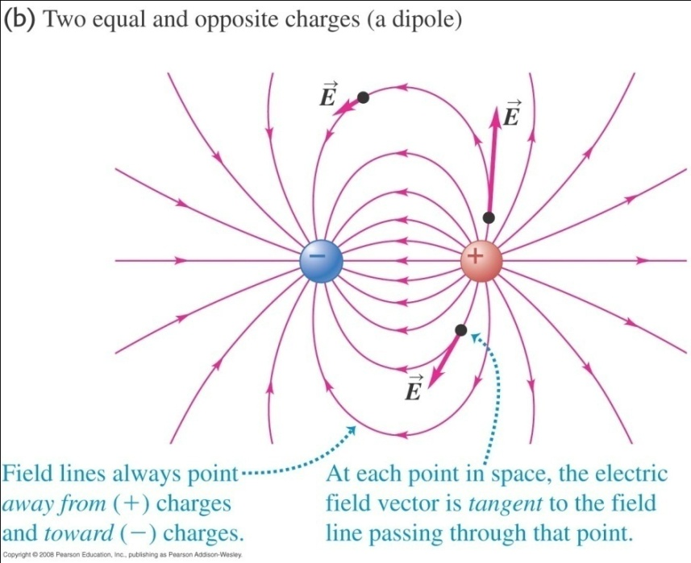
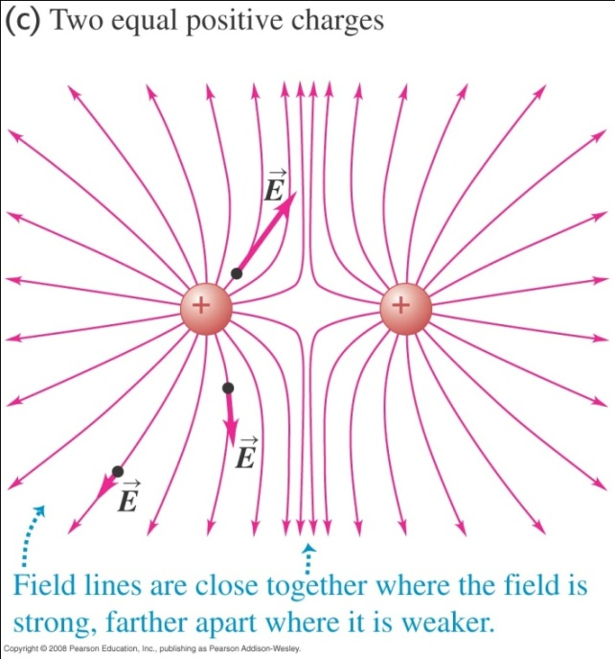
Electric field of two point charges
The electric field of two point charges is the resultant of their individual fields.
We will study simple cases where the charges do not distort each other’s field.

Slide 16
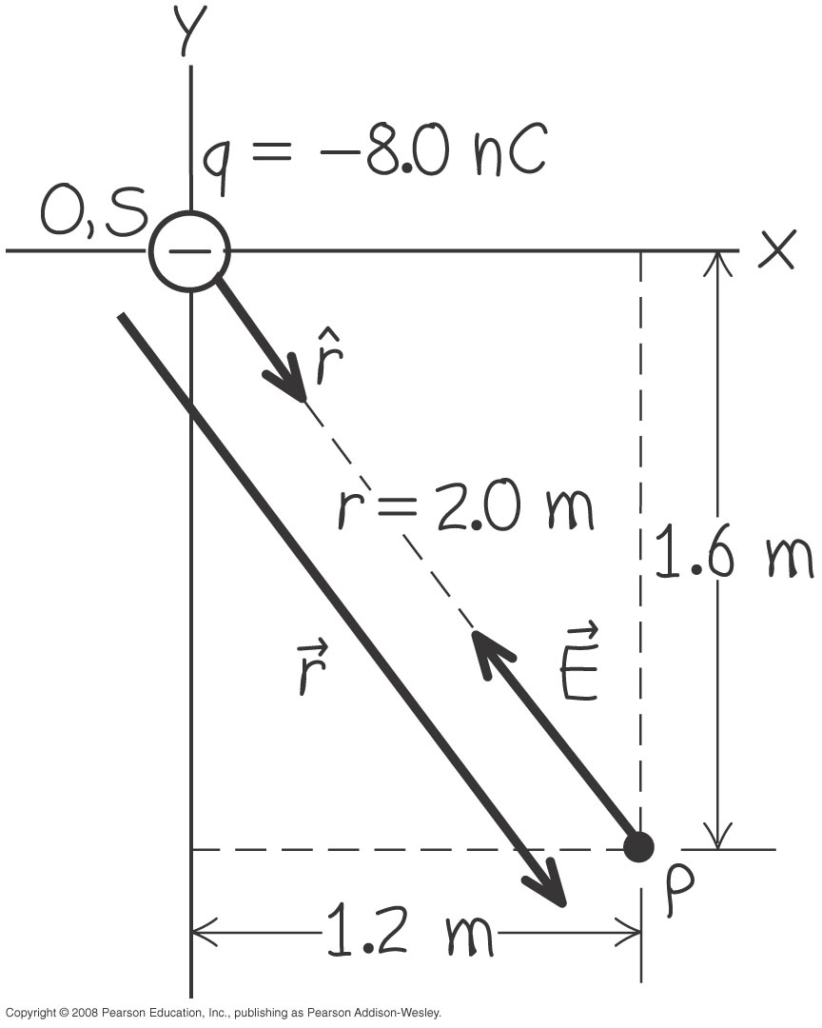
Example 4
A point charge q = −8.0 nC is located at the origin. Find the electric field vector at the point x = 1.2 m, y = − 1.6 m.
Notes:
E = (−11 N/C) i + (14N/C) j

Slide 17
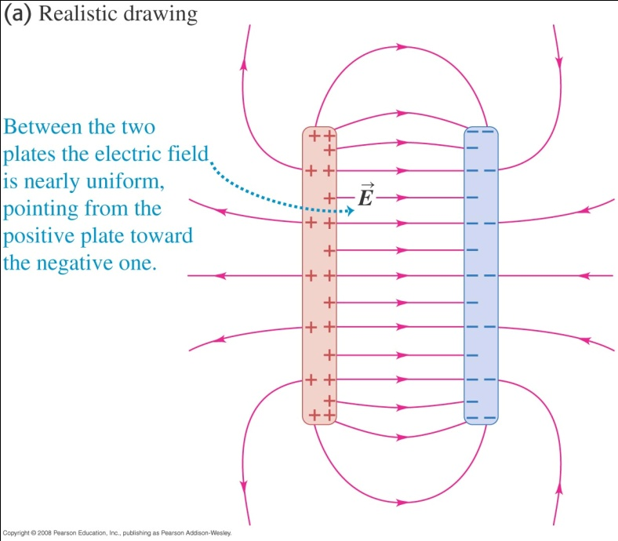
Electric field between two parallel plates
The electric field between two parallel plates is uniform except near the edges of the plates.
From , we have
A charge within a uniform field will experience the same force no matter where it is placed.

Slide 18
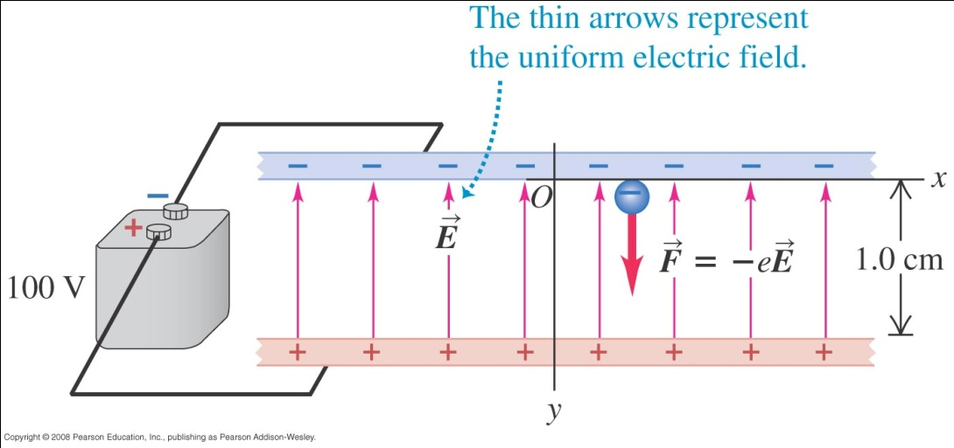
Example 5
The diagram shows a uniform electric field of magnitude E = 1.00 x 10⁴ N/C. Mass of an electron is 9.11 × 10⁻³¹ kg.
a) If an electron is released from rest at the upper plate, what is its acceleration?
b) What speed and kinetic energy does the electron acquire travelling 1.0 cm to the lower plate?
c) How much time is required for it to reach the lower plate?
Notes:
a = −1.76 × 10¹⁵ m/s²
v = 5.9 × 10⁶ m/s, KE = 1.6 × 10⁻¹⁷ J
t = 3.4 × 10⁻⁹ s

Slide 19
Superposition of electric fields
If we have a distribution of charge, we can imagine it to be made up of many point charges.
The total force on a charge q₀ due to the fields of all the point charges is
Hence, the overall field is the superposition of electric fields which is

Slide 20
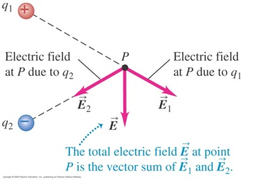
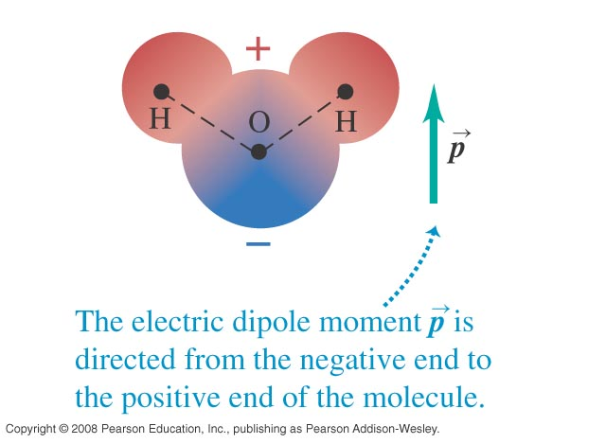
Field due to two equal but opposite charges
Such an arrangement of charges is known as an electric dipole.
The total field at P is
where
The water molecule is a natural dipole.
x
r₁
2a
r₂

Slide 21
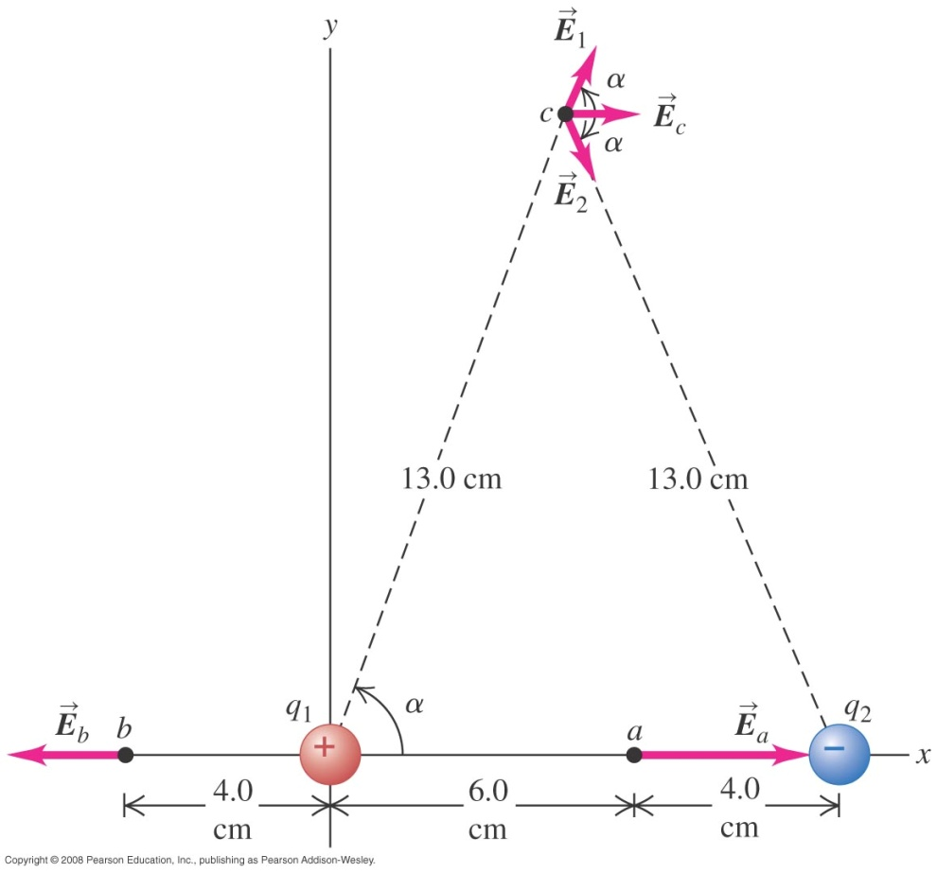
Example 6
Point charges, q₁ = +12 nC and q₂ = −12 nC, placed 10 cm apart (see figure). Compute the total electric field at point a, b and c.
Notes:
(a) E_{a} = (9.8 × 10⁴ N/C) i
(b) E_{b} = (−6.2 × 10⁴ N/C) i
(c) E_{c} = (4.9 × 10³ N/C) i

Slide 22
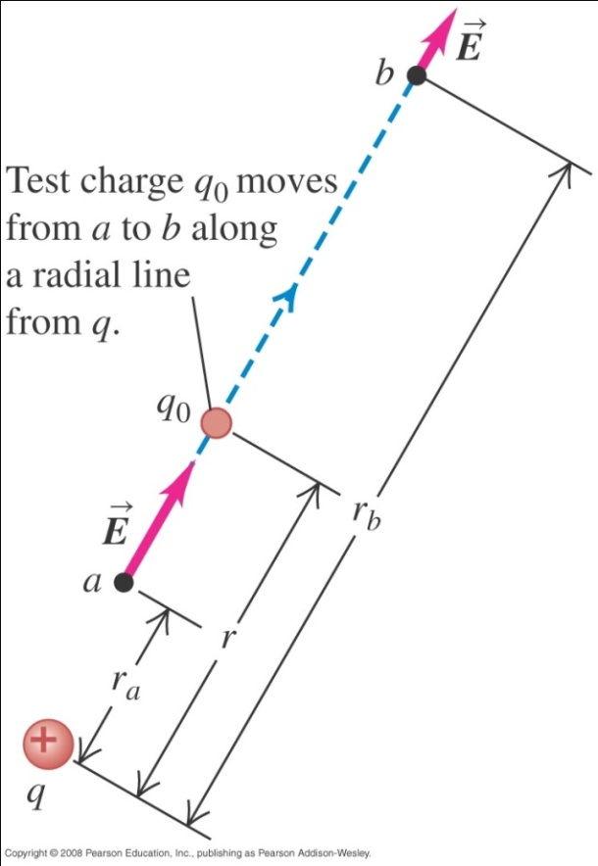
Potential energy due to one point charge
In the diagram, q and q₀ are positive point charges.
The force on q₀ is
The work done by this force to move q₀ from a to b is

Slide 23
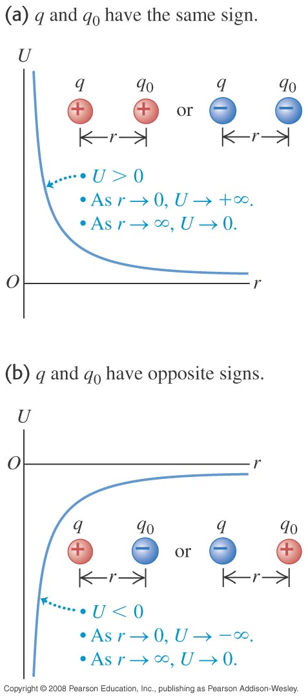
Potential energy due to one point charge
In general, at any point r from q, the electric potential energy of q₀ is
If q and q₀ have the same sign, U > 0
If q and q₀ have opposite signs, U < 0

Slide 24
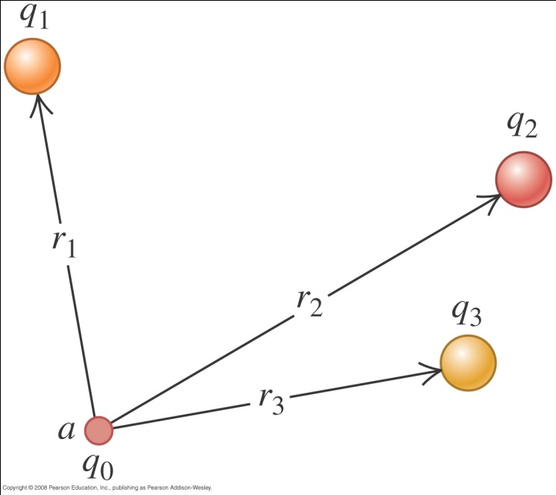
Potential energy due to several point charges
When there are several point charges around q₀, the electric potential energy of q₀ is the algebraic sum of all the electric potential energy due to the individual point charges, i.e.

Slide 25
Electric potential
Electric potential (V) is defined as the potential energy (U) per unit charge associated with the test charge q₀ at that point, i.e.
The SI unit of electric potential is joule per coulomb (J/C) or volt (V).
For a radial field due to a point charge, the potential at any point r is

Slide 26
The electron-volt
From , we have U = q_{o}V
If q₀ = e = 1.6 x 10⁻¹⁹ coulomb and V is 1 volt, then
U = q₀V = eV = 1.6 x 10⁻¹⁹ coulomb × 1 volt = 1.6 x 10⁻¹⁹ J.
By definition, this amount of energy is called 1 electron-volt (eV).
Hence 1 eV = 1.6 × 10⁻¹⁹ J.
The unit of eV is widely used in atomic physics.

Slide 27
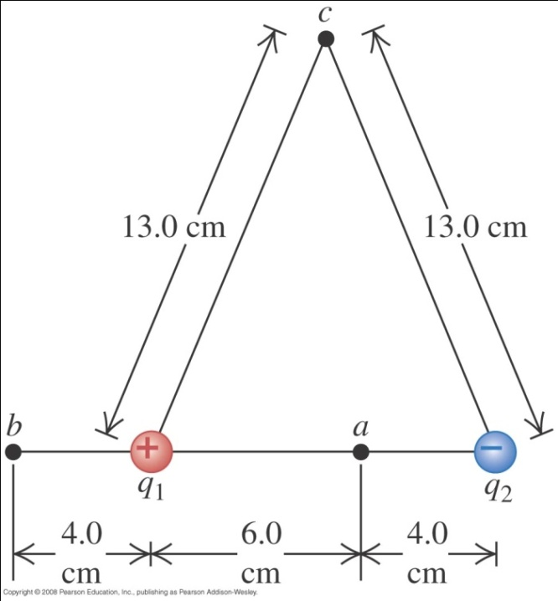
Example 7
An electric dipole consists of two point charges, q₁ = +12 nC and q₂ = −12 nC, placed 10 cm apart. Compute the potentials at point a, b and c by adding potentials due to either charge.
Notes:
V_{a} = −900 V, V_{b} = 1930 V, V_{c} = 0 V

Slide 28
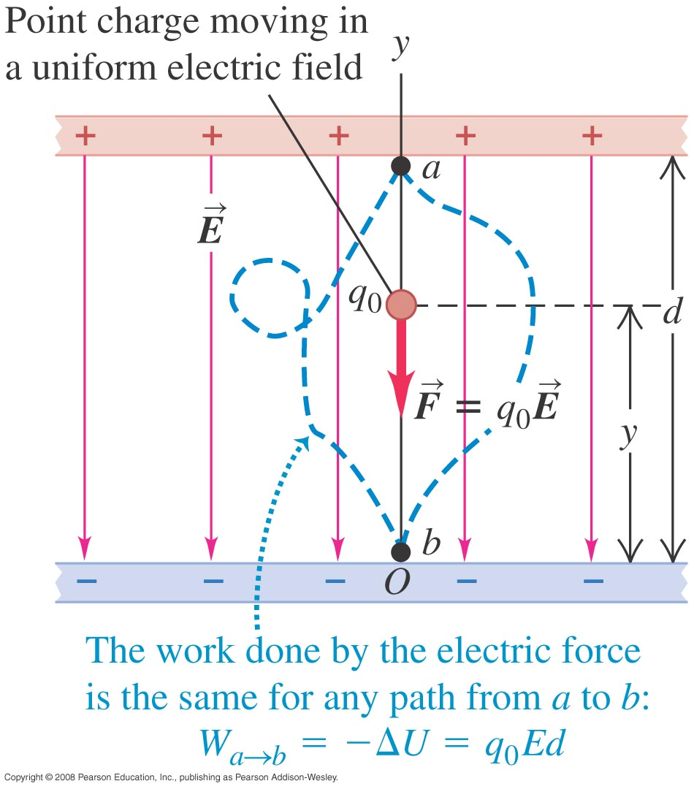
Electric potential energy – uniform field
If the upper plate is positive and lower plate is negative, a positive charge q_{o} will experience a downward conservative force
Since the field is uniform, the force on q_{o} is the same everywhere and the work done by the force to bring q_{o} from a to b is
If we take U_{a} at a to be zero, then

Slide 29
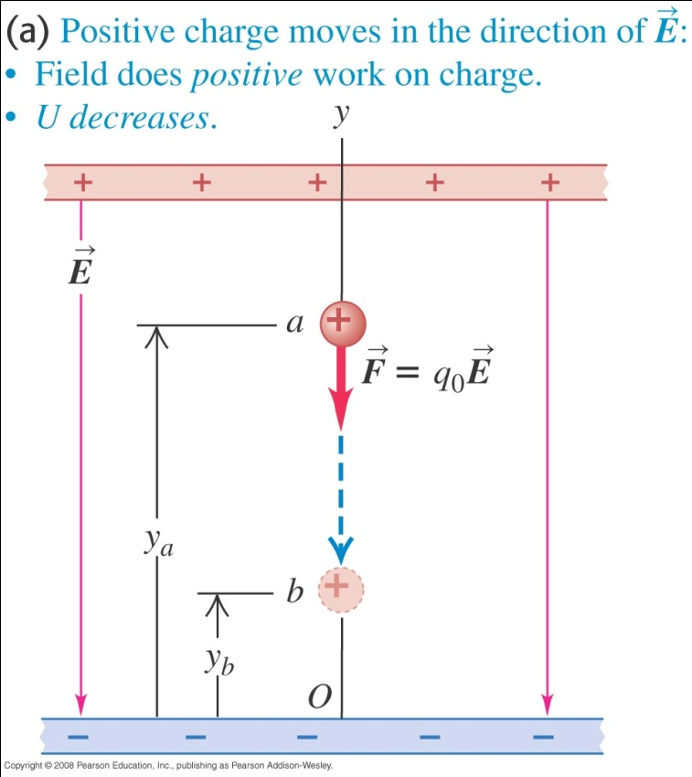
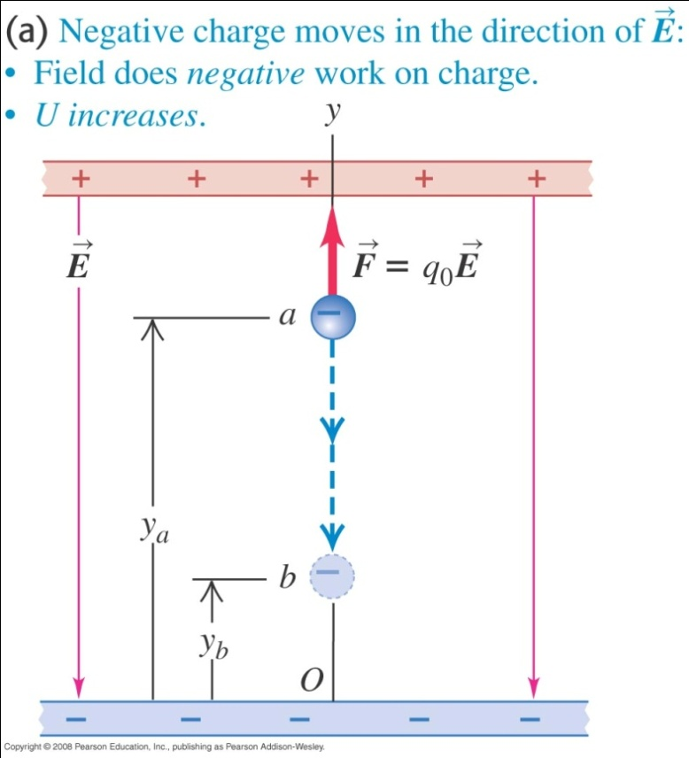
Electric potential energy – uniform field
If q_{o} is positive, its electric potential energy decreases as the charge moves in the direction of the field.
If q_{o} is negative, it electric potential energy increases as the charge moves in the direction of the field.

Slide 30
Example 8
A proton of charge 1.602 x 10⁻¹⁹ C, moves in a straight line from point a to point b inside a linear accelerator, a total distance d = 0.50 m. The electric field is uniform along this line, with magnitude E = 1.5 x 10⁷ V/m in the direction from a to b. Determine
a) the force on the proton
b) the work done on it by the field
c) the potential difference V_{a} - V_{b}
Notes:
F = 2.4 × 10⁻¹² N
W = 1.2 × 10⁻¹² J or 7.5 MeV
V_{a} – V_{b} = 7.5 MV

Slide 31
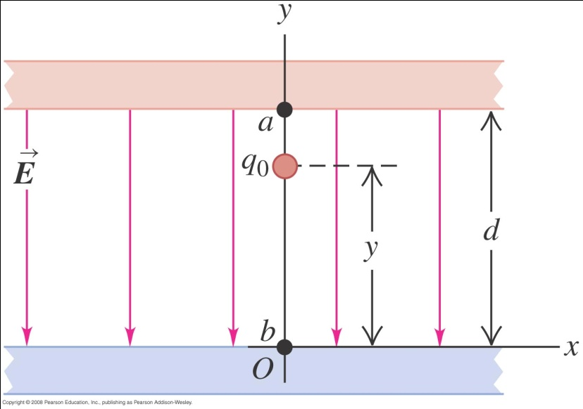
Example 9
An electric potential difference of 2000 V is applied to a pair of plates that is separated by 1 cm. If a particle of charge 6.40×10⁻¹⁹ C is released from the upper plate
a) What is the electric field (that is uniform) in the region between the plates?
b) If the mass of the particle is 1.92×10⁻¹⁶ kg, what is the speed of the particle as it reaches the bottom plate?

Slide 32
Electric potential gradient
In general, for a non-uniform field
If the field is uniform and the displacement of the charged particle is in the same direction as the field, φ = 0, then
Hence, another unit of E is V/m.

Slide 33
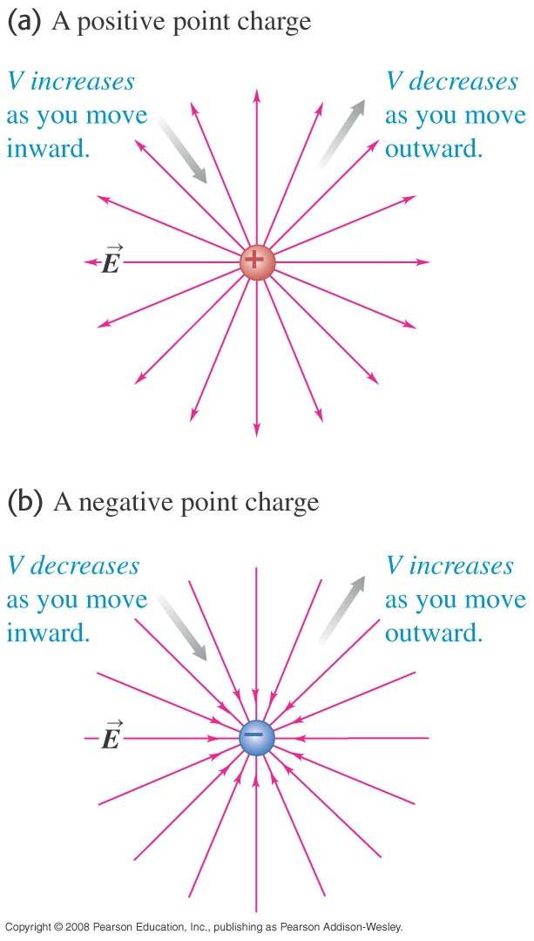
Electric field from potential of point charge
From the definition of work and potential,
For a point charge,
Since he field is radial, , the integral is straight forward.

Slide 34
Optional Slides

Slide 35
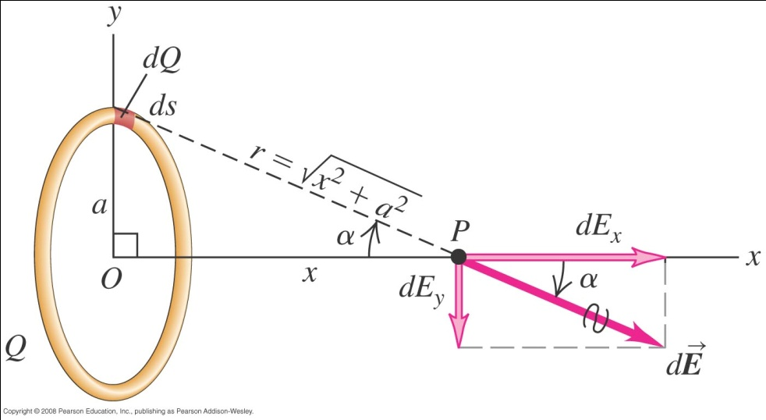
Electric field due to a ring of charge
From symmetry, at P the electric field E_{y} = 0.
The electric field dE_{x} at point P due to a small segment of a charged ring is
Hence

Slide 36
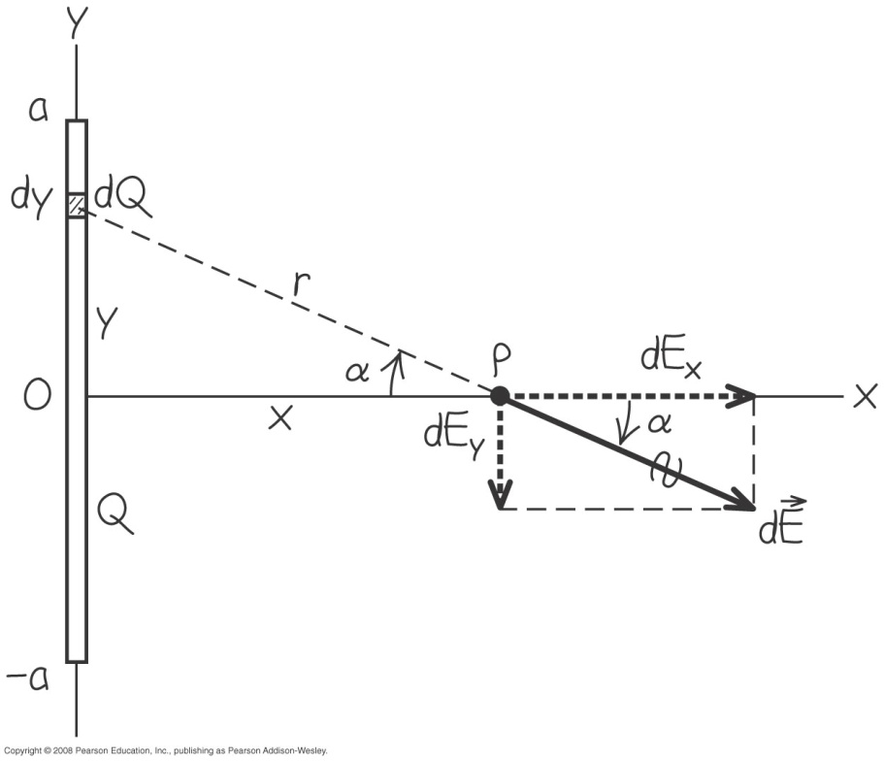
Electric field due to a charged line segment
From symmetry, at P the electric field E_{y} = 0.
The electric field dE_{x} at point P due to a small segment of a line segment ring is
Hence

Slide 37
Millikan oil drop experiment
A negatively charged oil drop is held stationary between two charged plates.
qE = mg, or q = mg/E
If we know the mass of the oil drop, and the electric field, we can calculate the charge on the oil drop!
+ + + + + + + +
qE
-
mg
- - - - - - - -

Slide 38
Example 10
In a particular Millikan oil drop apparatus, the plates are 2 cm apart. An electric field strength field of 5 × 10⁴ N/C caused an oil drop to become stationary. The oil used has a density of 885 kgm⁻³.
a) What is the potential difference that is applied to the plates?
b) The oil drop has a volume of 7.24 × 10⁻¹⁸ m³. What is the charge on the oil drop?
c) If the oil drop is negatively charged, how many extra electrons does it have?

Slide 39
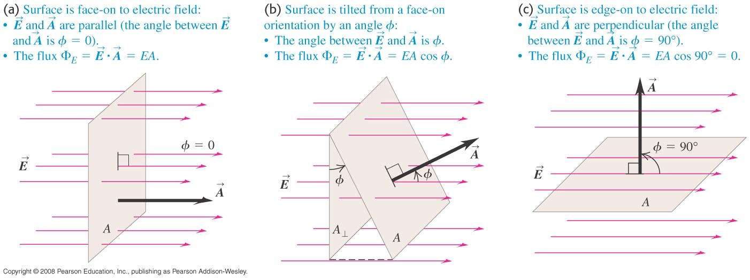
Electric flux
Electric flux, Φ is defined as
where φ is the angle between the normal to the surface and .
If is non-uniform,

Slide 40
Gauss law
Gauss’ law states that “The net electric flux coming out of a closed surface is proportional to the net electric charge inside the surface.”
Mathematically,
The constant of proportionality is ε or ε₀ if the charge is in a vacuum.
Hence
If the charge is in vacuum, then

Slide 41
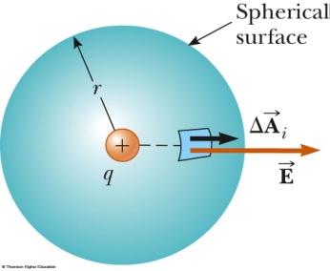
Coulomb’s law from Gauss law
Suppose a positive point charge, q, is at the center of a sphere radius r.
This formula is the same as the one derived using Coulomb’s law.

Slide 42
End of chapter

